Slide 1

Car Accident Alert System
Deep learning project
Real time car accident alert system through live CCTV cameras

Slide 2
METHODOLOGY
1
2
3
4
Overview
Data Description
Experiments
Data
Visualization
5
Demo
6
Future Work

Slide 3
As we know the frequency of road accidents has exponentially increased, Road accidents are a serious issue all over the world. An indicator of survival rates after detecting accidents is the time between the occurrence of accidents and the advent of medical care to the victim, As a solution to these problems we are providing a model to detect an accident as soon as it occurs and send an alert to the emergency services.
Overview

Slide 4
The dataset has been collected from kaggle. It’s a CCTV images was labelled as Accident and Non-Accident.
Data Description

Slide 5
Neural Networks
Transfer Learning
(ResNet50 model)
Freezing the pre-trained
(ResNet50)
Full CNN model
Unfreeze part of the base model
Fitting the Dataset into the Model
Notes:
Stochastic Gradient Descent (SGD) for learning weights
Adv:
SGD helps the model to converge fast empirically in case of large training data set
Using SGD, one can achieve better generalization when using the model for predicting population or unseen data set.
unfreeze part of the base model and retrain the whole model end-to-end with a very low learning rate.(ues if condition and for loop to see which layer freezedor not )

Slide 6
Experiments
Sigmoid | SoftMax | Accuracy
95% | 93% | Validation
93% | 90% | Test
epochs=40

Slide 7
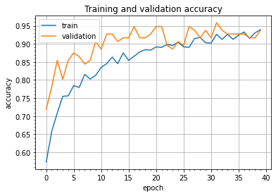
Accuracy Chart
Training
93%
Validation
95%

Slide 8
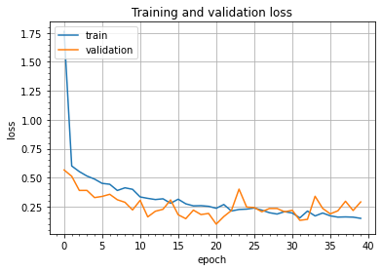
Loss Chart
Training
14%
Validation
29%

Slide 9
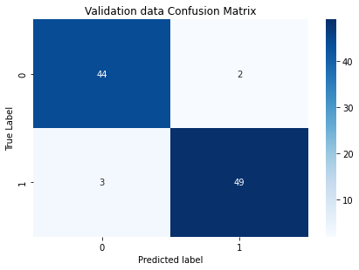
Validation Confusion Matrix
Accuracy : 95%
loss : 1%

Slide 10
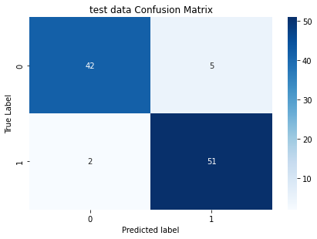
Test Confusion Matrix
Accuracy : 93%
loss : 19%

Slide 11

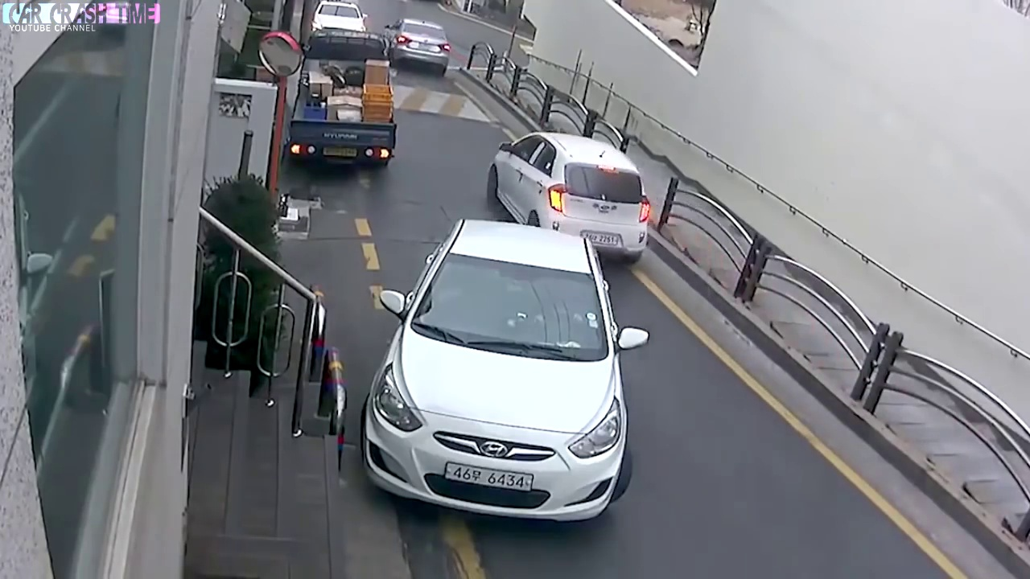
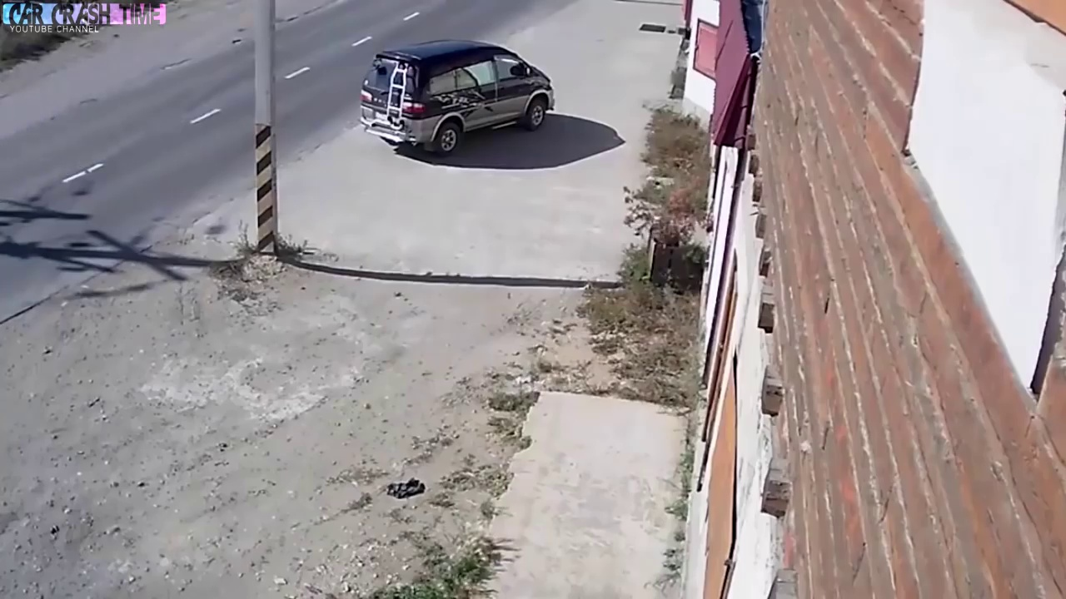
Image Results
Model's prediction:
No Accident
Model's prediction:
No Accident

Slide 12
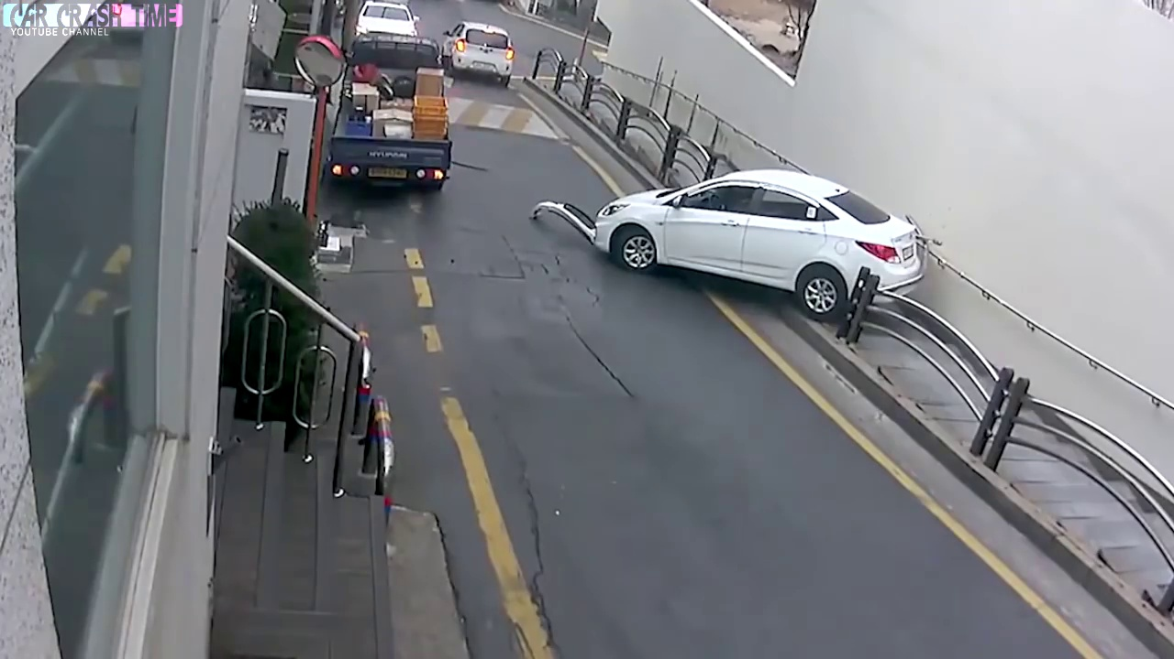
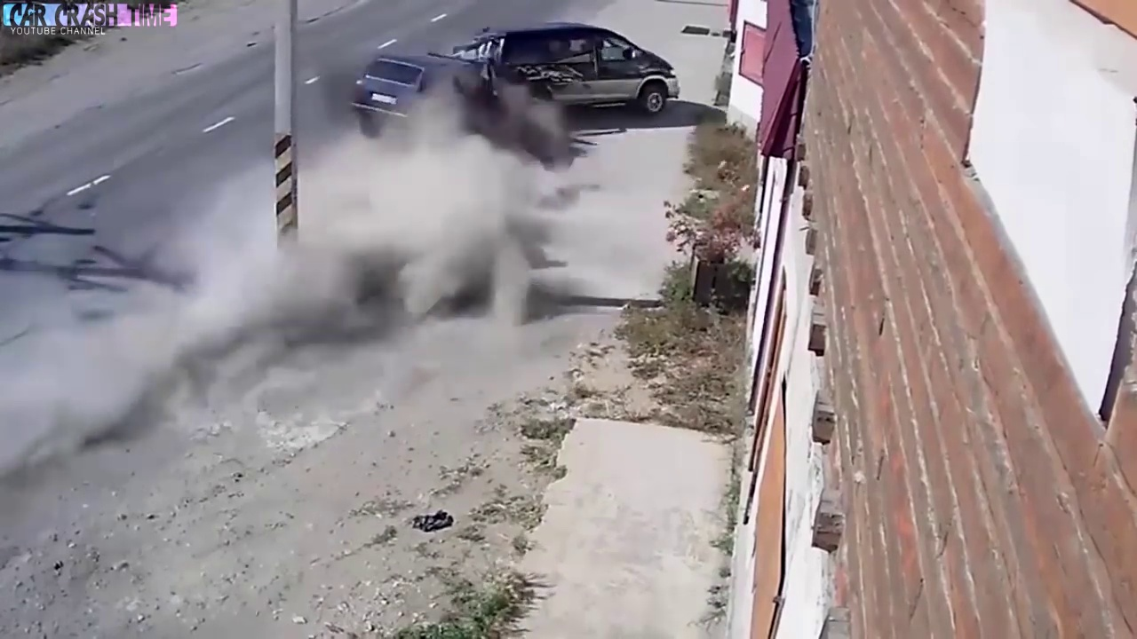
Image Results
Model's prediction:
Accident
Model's prediction:
Accident

Slide 13
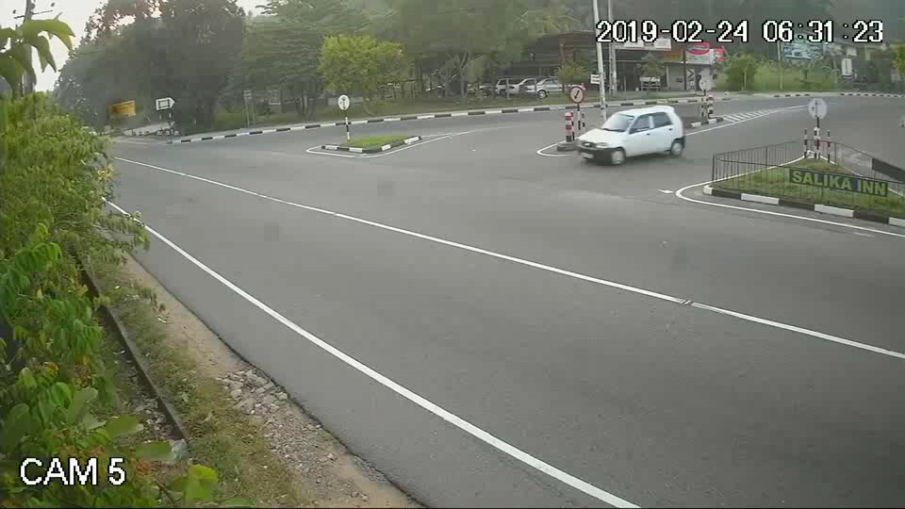

Our Website

Slide 14
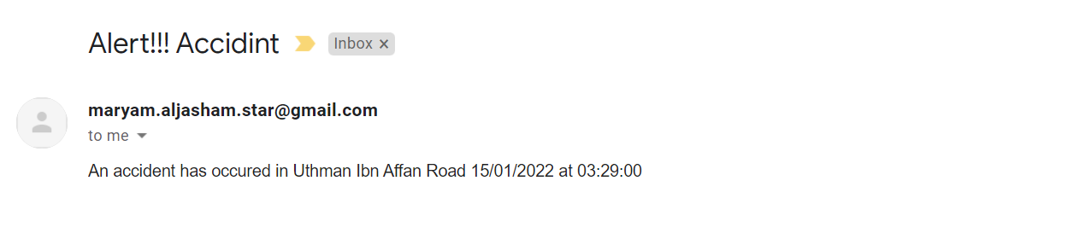
Alert System

Slide 15
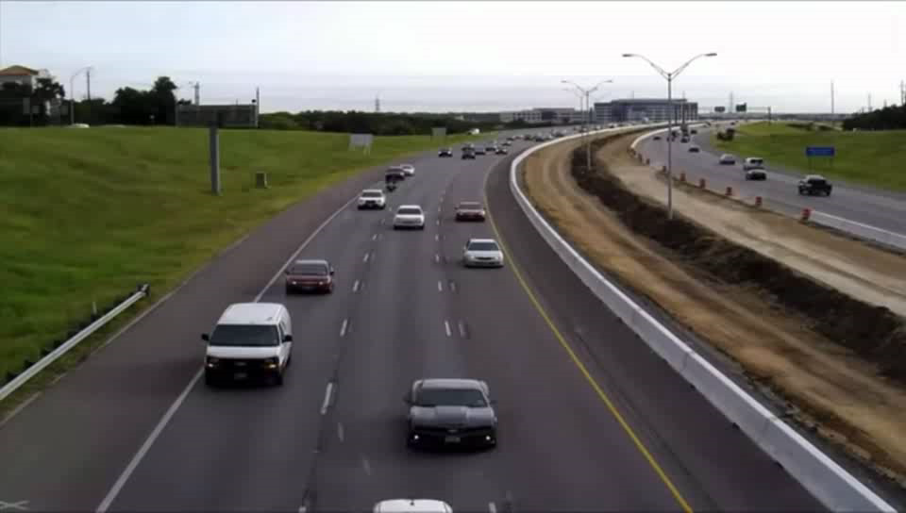
Our Website

Slide 16
Future Work
Increase the accuracy by adding more data for CCTV in Saudi Arabia’s roads
Improve the model to Determine whether the accident is strong or not to call an imbalance

Slide 17
Thank you .. Raghad Albarrak Maryam Aljasham

